Slide 1



STUDENT PERFORMANCE INDICATOR
Mayur Bk

Slide 2
OUTLINE
Executive Summary
Introduction
Methodology
Results
Conclusion
Appendix

Slide 3
EXECUTIVE SUMMARY
The project summarizes about, How the students performance in the test scores are affected by various variables such as Gender, Ethnicity, Parental level of education, Lunch and Preparation for the test
By using different ML models and taking into consideration of all the factors that are affecting the students test performance scores, we found that the test performance scores are mainly affected by student’s test preparation, background and the food intake.
Successfully computed the model with the help of linear regression along with the accuracy of 88.04% and deployed the model in Flask and AWS Beanstalk.

Slide 4
INTRODUCTION
The dataset provides us with the data of the students which has their test scores for a particular subject.
Along with various factors that are (Gender, Lunch type, Preparation for the test, Race/Ethnicity, Parents level of education)
Objective of the project
To find the score of the student after taking into consideration for all the factors that affect their test performance.

Slide 5
METHODOLOGY
Data Source
Data Preprocessing
Data Visualization
Model Training
Model Deployment

Slide 6
Data Source
Data Source - https://www.kaggle.com/datasets/spscientist/students-performance-in-exams?datasetId=74977

Slide 7
Data Preprocessing
Check Missing values
Check Duplicates
Check Datatype
Check the number of unique value in each column
Check the statistics of the dataset
Check the various categories present in different categorical column

Slide 8
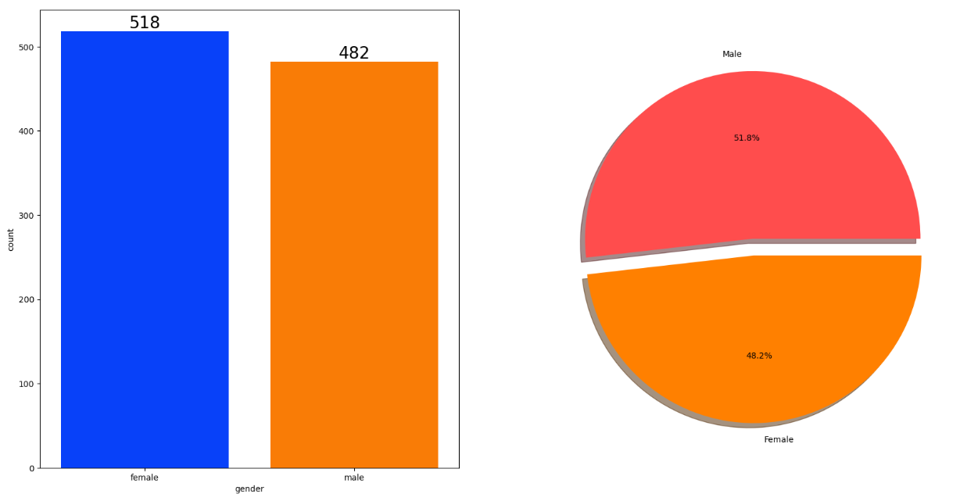
Data Visualization
Scores wrt. Gender
Male
count
Female
F
M
gender

Slide 9
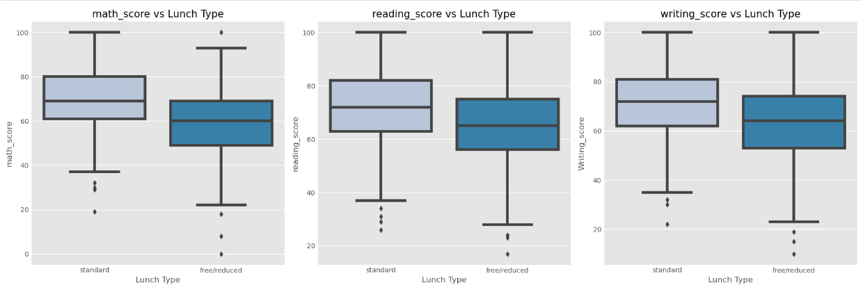
Score wrt. Lunch type

Slide 10
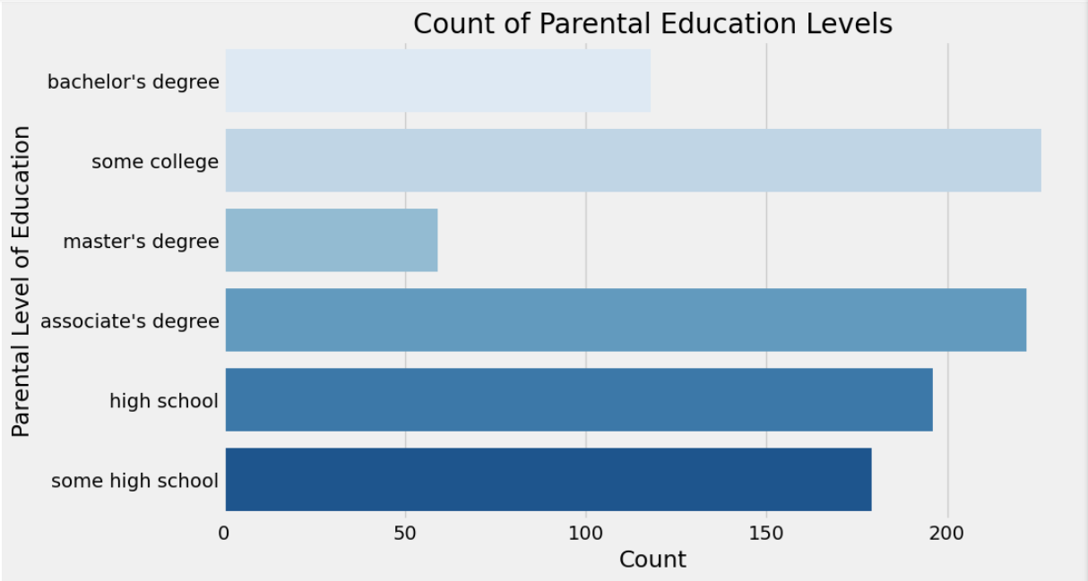
Score wrt. Parent Level Education

Slide 11
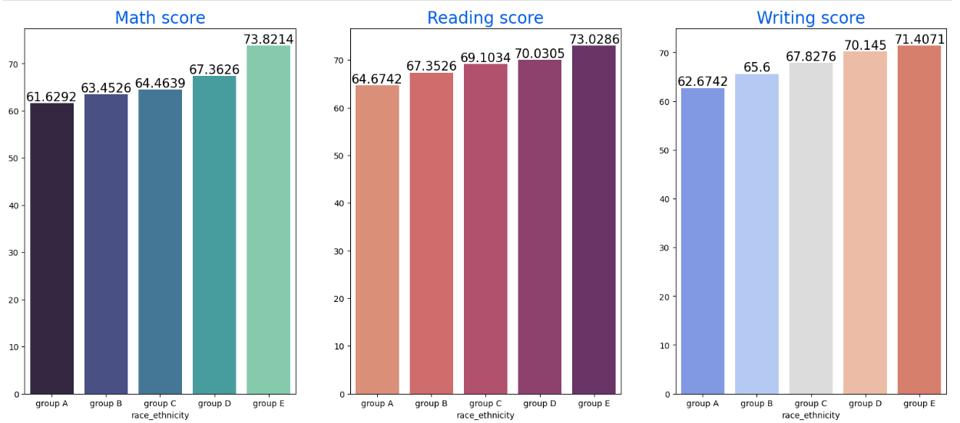
Score wrt. Race/Ethnicity

Slide 12
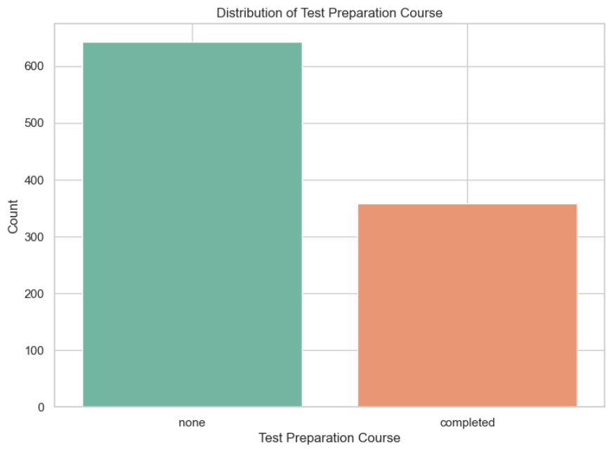
Score wrt. Test Preparation

Slide 13
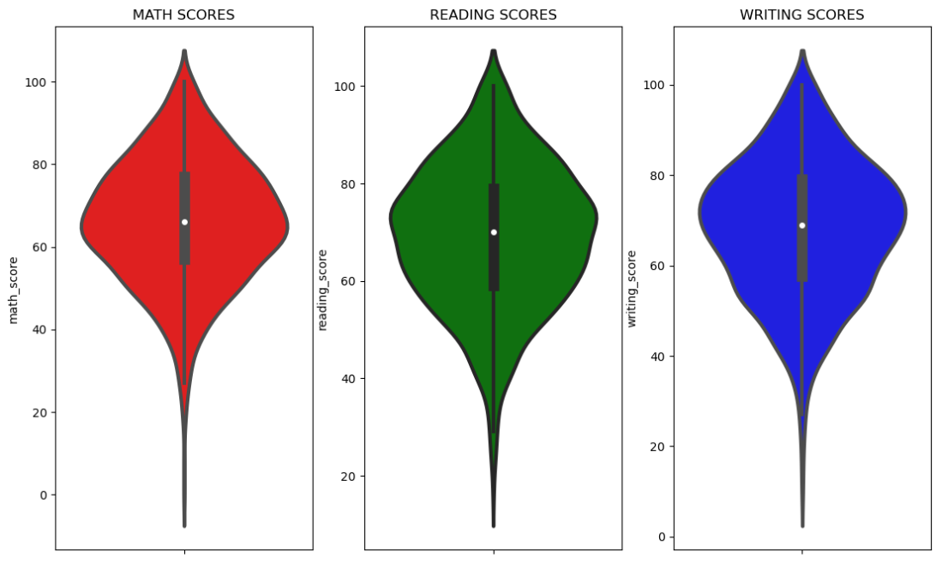
Maximum Scores

Slide 14
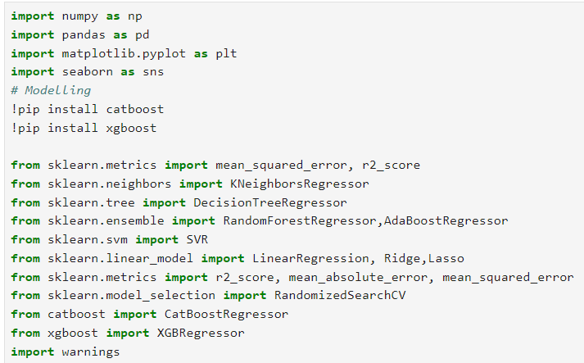
Model Training
REQUIRED PACKAGES

Slide 15
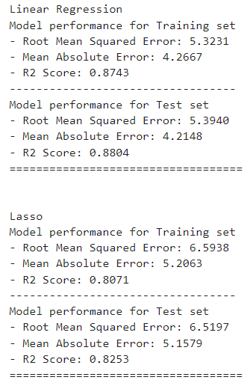
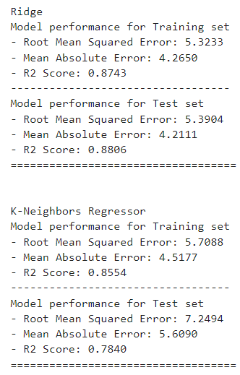
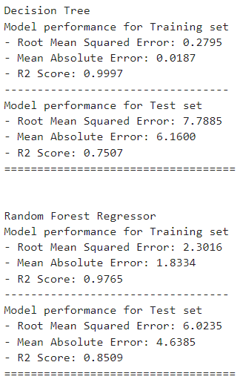
Different models and their validation scores

Slide 16
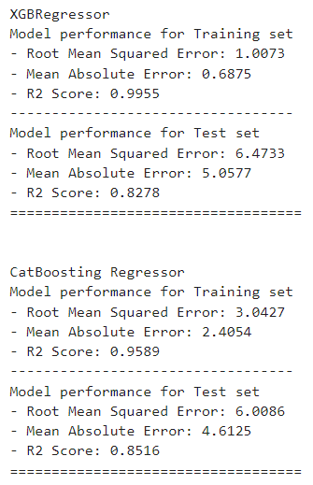
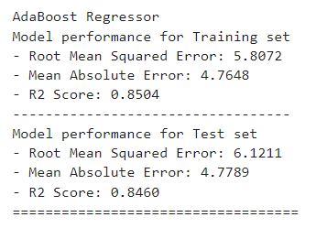

Slide 17
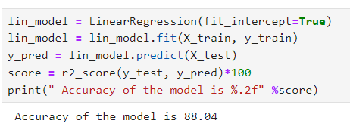
RESULTS
Finally the Linear regression model is taken into consideration.
Since it has the most accuracy among all the other models used

Slide 18
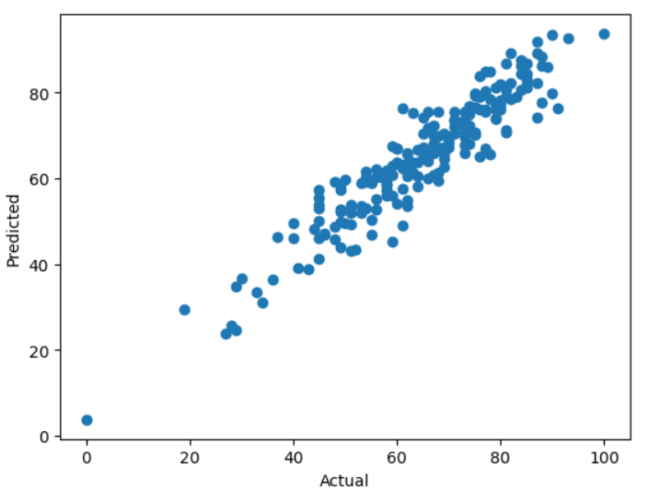
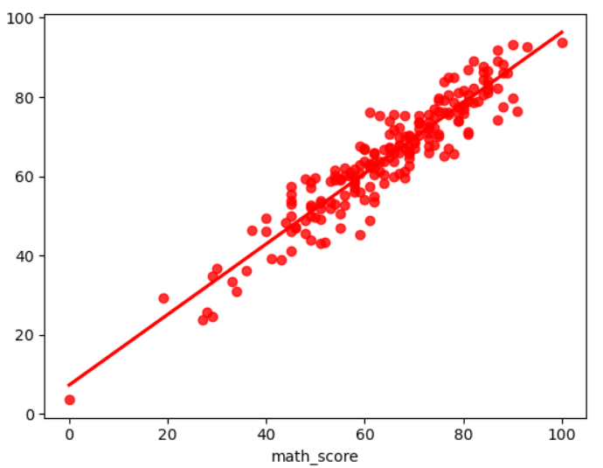

Slide 19
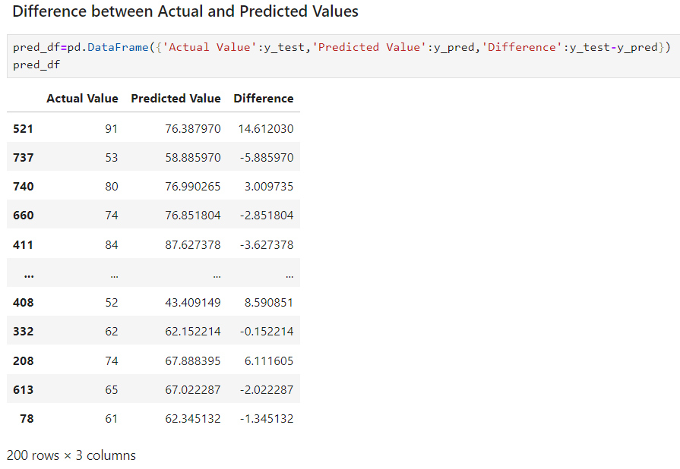

Slide 20
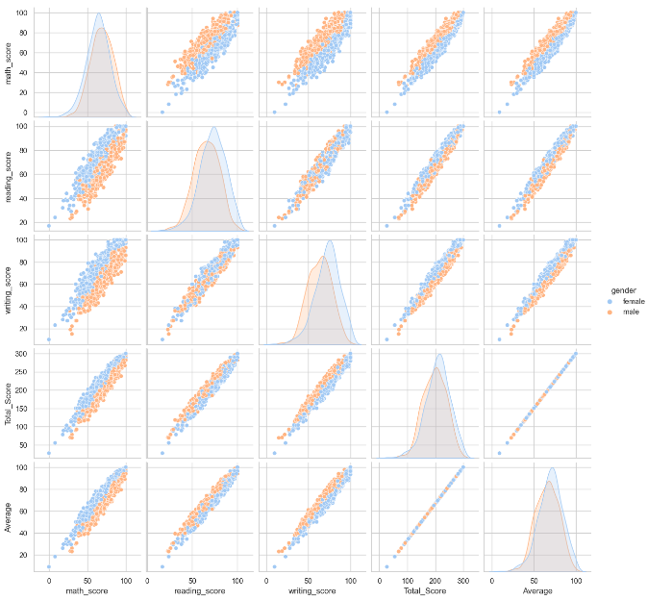

Slide 21
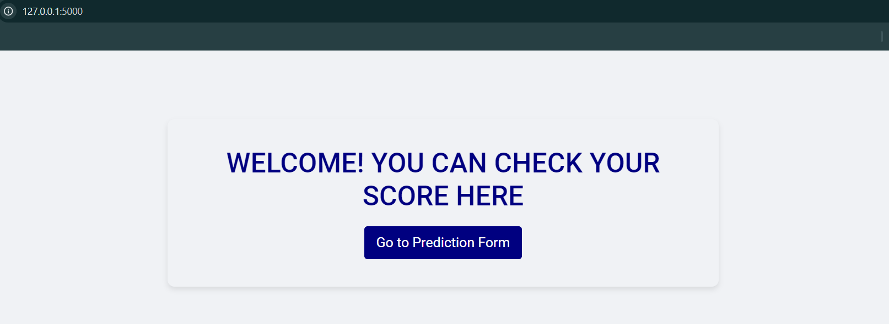
MODEL DEPLOYMENT
Deployment Index page

Slide 22
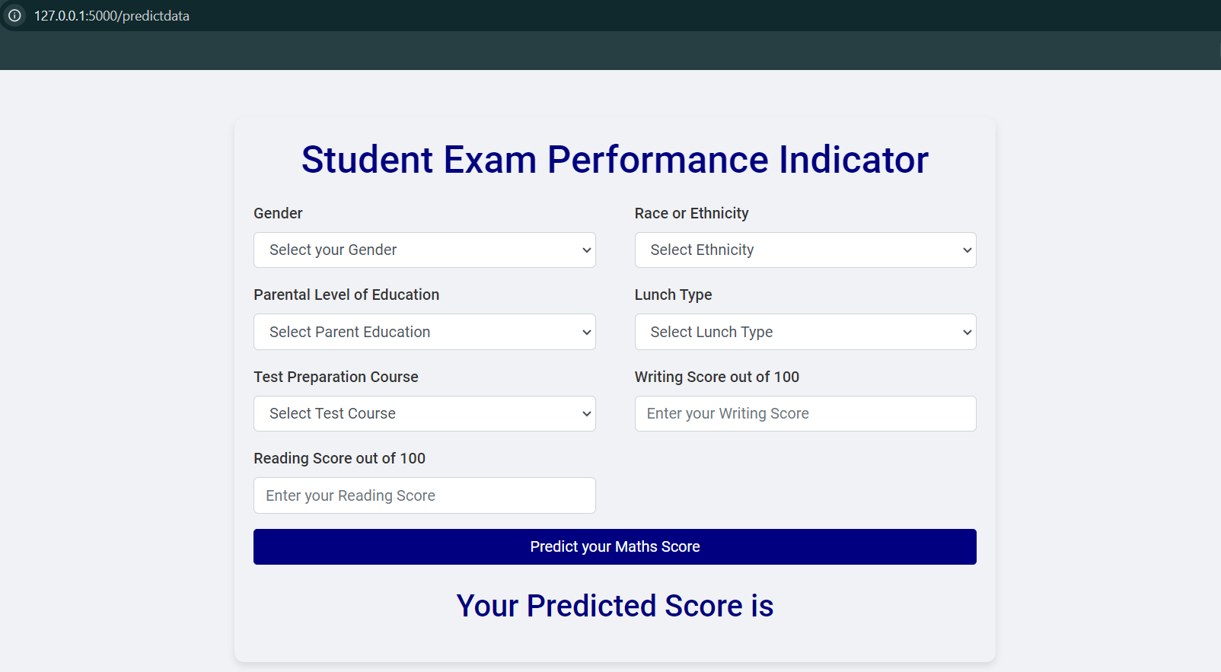
Deployment Homepage

Slide 23
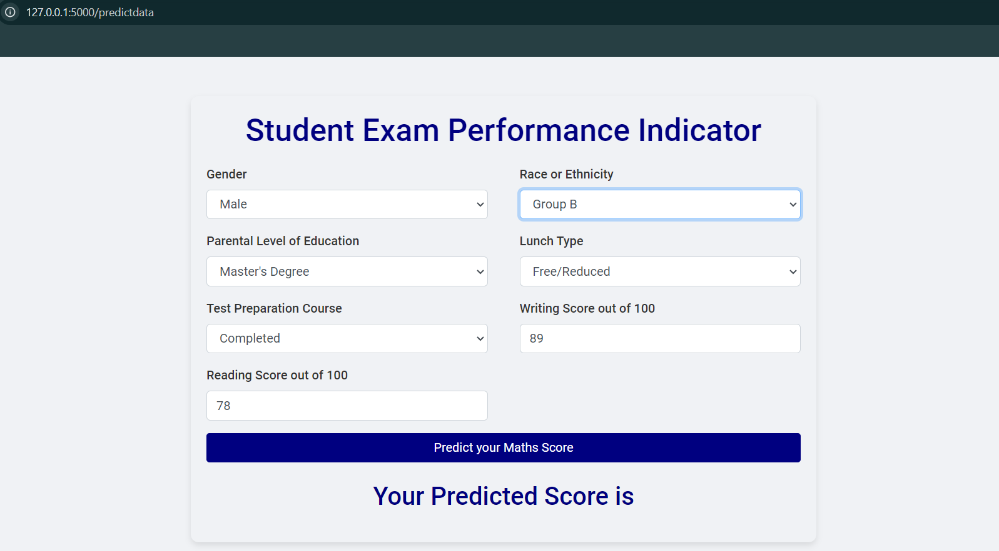
Data input for calculation

Slide 24
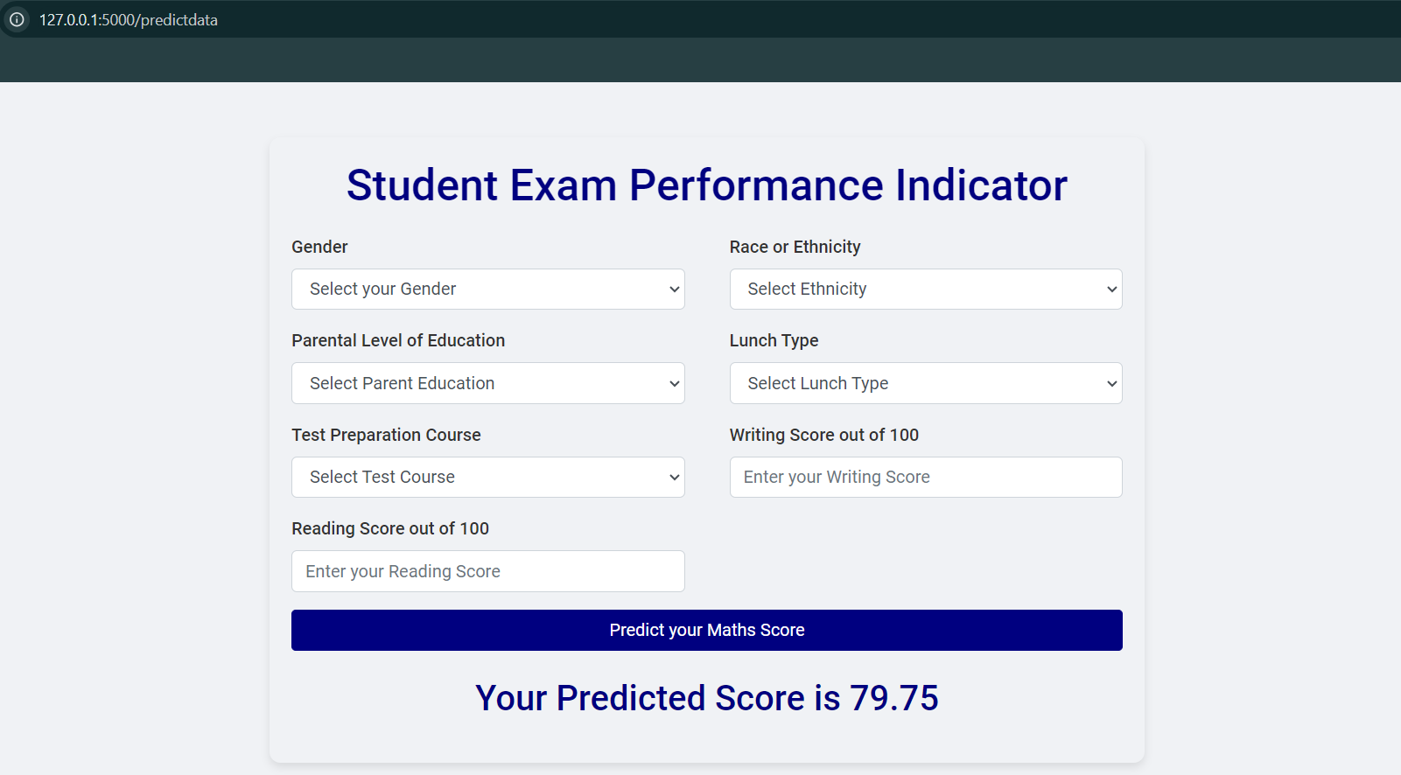
Final Predicted Score

Slide 25
CONCLUSION
Student's Performance is related with lunch, race/ethnicity and parental level education.
Females lead in pass percentage and also are top-scorers.
Student's Performance is not much related with test preparation course.
Finishing preparation course is beneficial.
Successfully Deployed the model in Flask and Aws Beanstalk.

Slide 26
APPENDIX
Please find the complete details of the project from my GitHub repository.
https://github.com/Mayur-Bk/Student-Performance-Indicator
Flask Deployment.
http://127.0.0.1:5000/

Slide 27
THANK YOU

